Slide 1
USI & SUPSI Source Code Management (SCM)
Finiletti Simone, Beffa Bryan

Slide 2
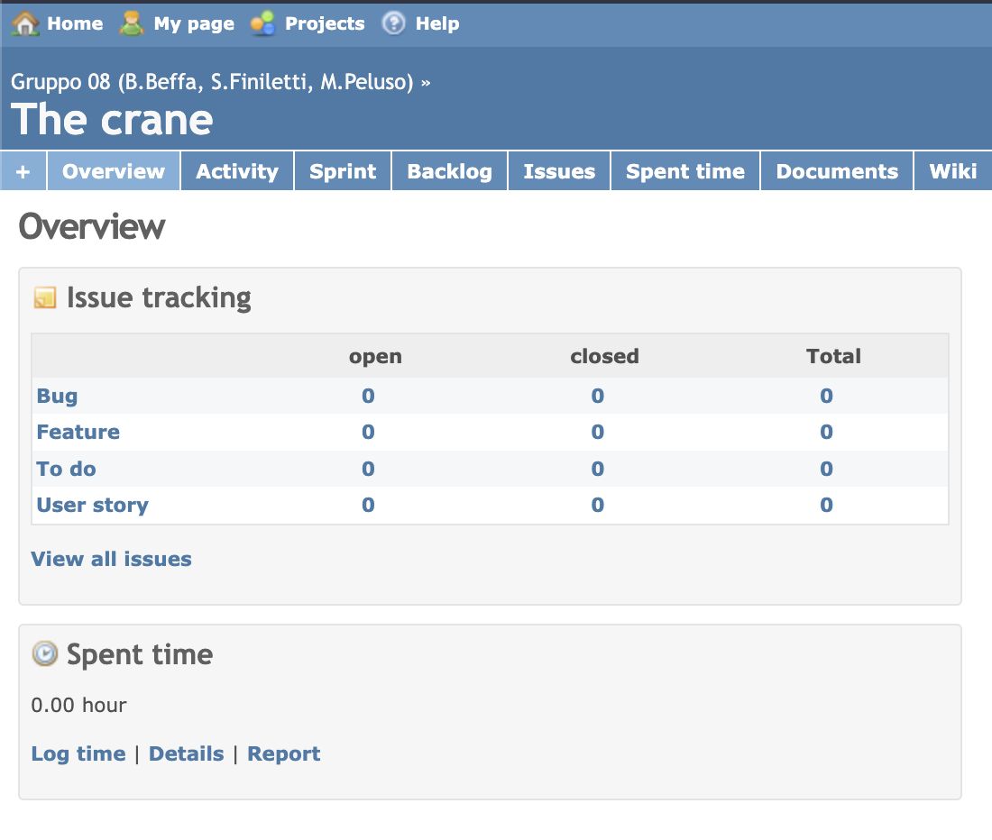
Project overview
The product:
This website offers to USI & SUPSI students and collaborators a way to work on repositories and manage other project operations.
Project duration:
December 2022

Slide 3
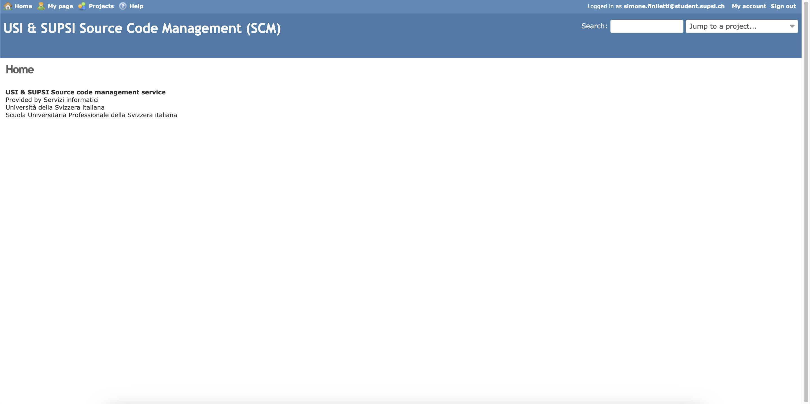

Slide 4
Project overview
The problem:
Low usability, Mediocre Intuitivity and Bad design
The goal:
Refactor website appearance and add new useful functionalities grouping them in appropriate pages.

Slide 5
Methods
Questions
Qualitative results
Quantitative results
Understanding
the user

Slide 6
User research: summary
We asked SCM users to describe the major difficulties they found in its use. We interviewed some students taking the computer engineering course.
We asked them to specify which features are missing and how much they like or dislike the organization of the pages.

Slide 7
User research: method
1
2
3
4
Question 1
Question 2
Question 3
Question 4
Describe how you feel about the appearance of the website.
Do you find it easy to reach your project repository overview? Yes/Almost/No
Do you think it’s easy for a new user to familiarize with the usage of the website? Yes/Almost/No
Which functionalities would you have ready-to-use once you log into SCM?

Slide 8
Quantitative results
Users find it generally easy to reach the repository overview page, but some experience is needed

Slide 9
Quantitative results
Users think that it’s not that easy for new users to familiarize with SCM.

Slide 10
Qualitative results
Users criticize the appearance of the website because they think that it is to careless to be a University Website and it’s to little intuitive. The general appearance (colors, disposition, ecc) feels obsolete and could need a refactor.
Users defined that SCM has all the functionalities but not all of them are easy to access. Expecially for new users, it’s hard to reach the information they need.

Slide 11
Defining
the user
archetype
Personas
Empathy maps
User stories

Slide 12
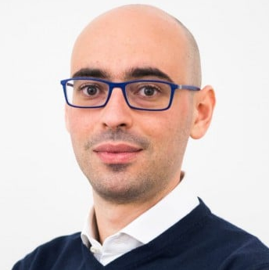
Persona 1
“Researcher that is an everyday user of SCM”
Goals
He wants to have the biggest number of repository managing features possible on SCM.
Frustrations
Want the website to be update to newer appearence standards
Christian
Age:
Education:
Hometown: Occupation:
34
IT Engineer
Lugano
Researcher
Christian is an everyday user of SCM and he likes that there are many features available on it. He has a lot of experience with the website but he may like a User Experience update.

Slide 13
Persona 1
SCM has a lot of features
The website is fine beacuse he knows it very well
User
Use the website every day to work and study
Comfortable with the website

Slide 14
Persona 2
“Relevant personal quote that captures the persona’s attitude and personality”
Add image that represents this persona
Goals
The related objectives this person wants to successfully complete
Frustrations
The issues or pain points that they encounter or try to avoid
Name
Age:
Education:
Hometown:
Family:
Occupation:
Brief story or scenario that conveys the persona’s user journey, highlighting their goals, frustrations, and other relevant context.

Slide 15
Persona 2
User

Slide 16
Persona 3
“Relevant personal quote that captures the persona’s attitude and personality”
Add image that represents this persona
Goals
The related objectives this person wants to successfully complete
Frustrations
The issues or pain points that they encounter or try to avoid
Name
Age:
Education:
Hometown:
Family:
Occupation:
Brief story or scenario that conveys the persona’s user journey, highlighting their goals, frustrations, and other relevant context.

Slide 17
Persona 3
User

Slide 18
User journey map
[Your notes about goals and thought process]
Image of user journey map

Slide 19
User research: pain points
1
2
3
4
Pain point
Pain point
Pain point
Pain point
Not intuitive for all to access to projects and repositories.
The feature of cloning a repo in not easily available.
The appearance of the website its outdated.
Home page is useless.

Slide 20
Paper wireframes
Digital wireframes
Low-fidelity prototype
Usability studies
Starting
the design

Slide 21
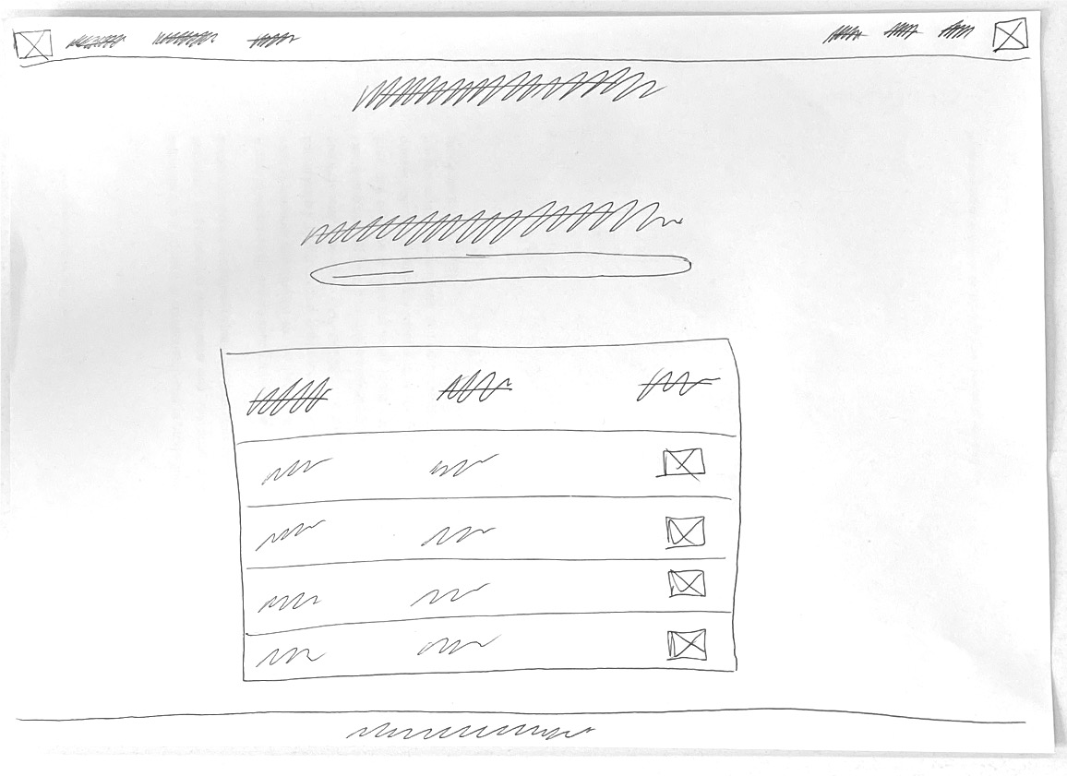
Paper wireframes
Home Page

Slide 22
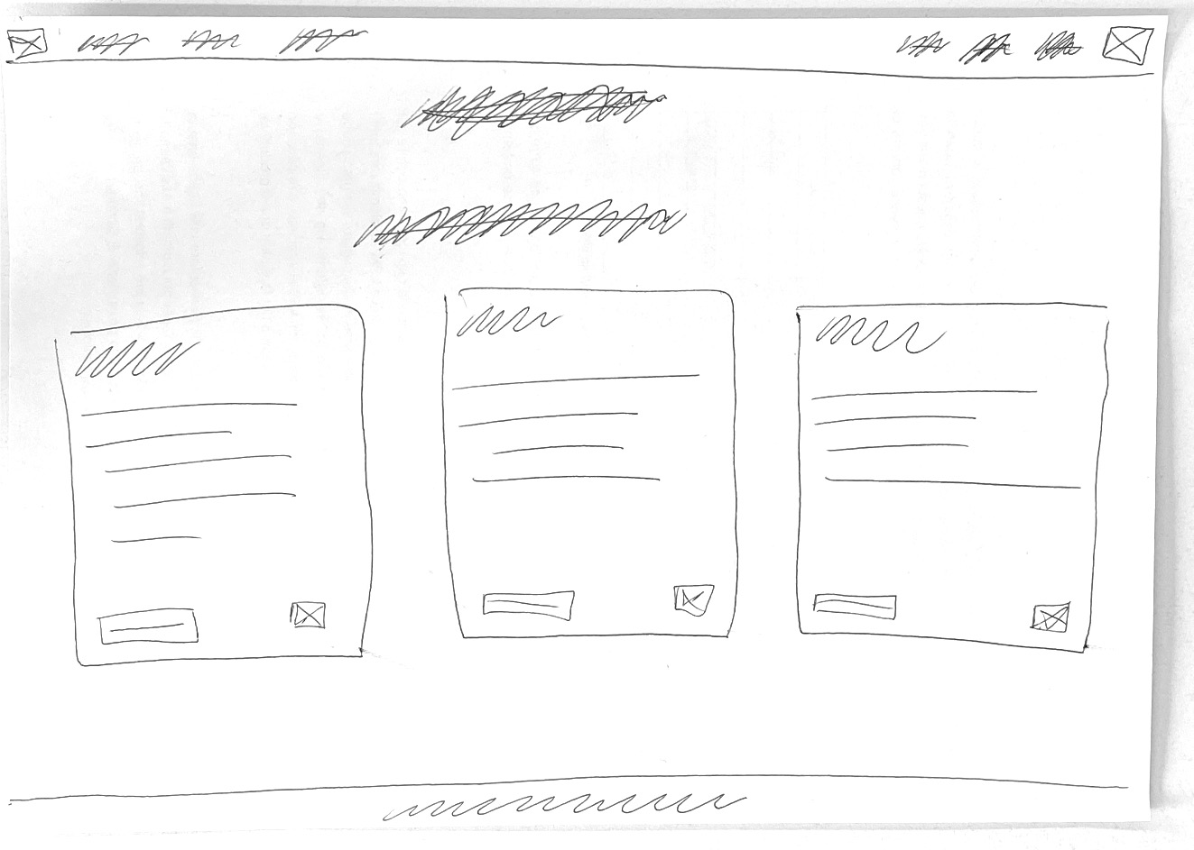
Paper wireframes
My Projects Page

Slide 23
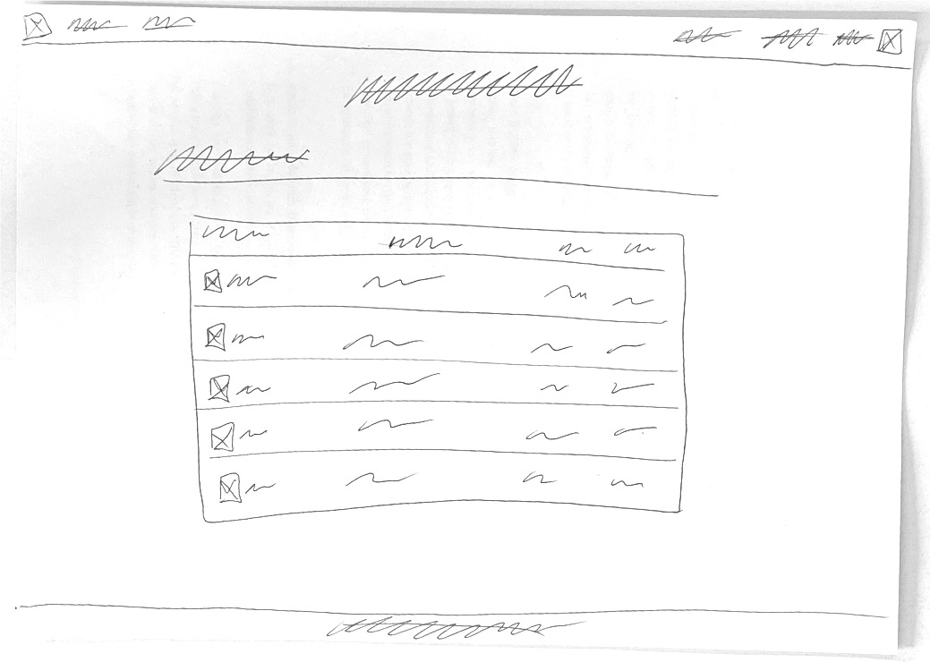
Paper wireframes
Project File Overview Page

Slide 24
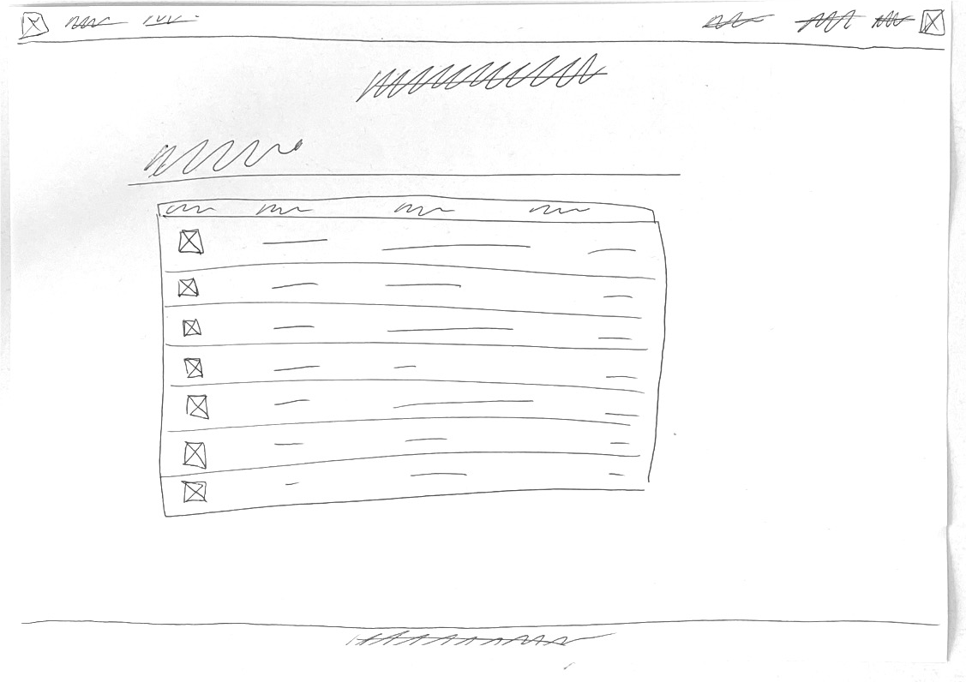
Paper wireframes
Project Commits Overview Page

Slide 25
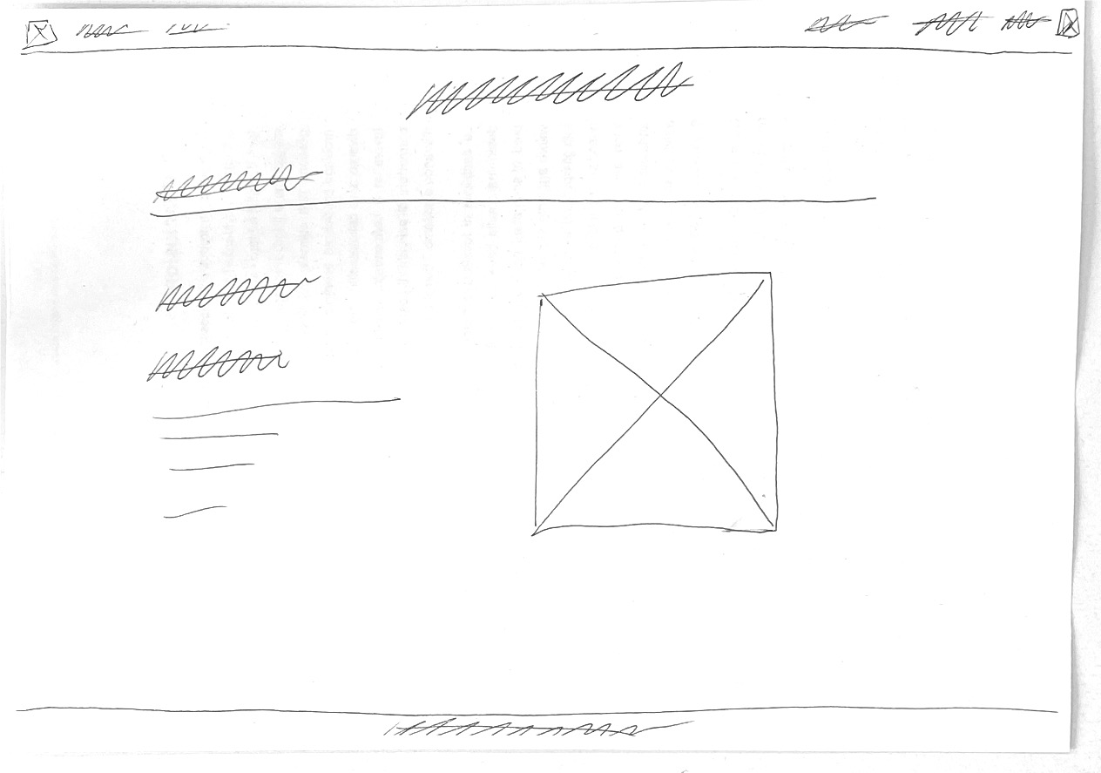
Paper wireframes
Project General Overview Page

Slide 26
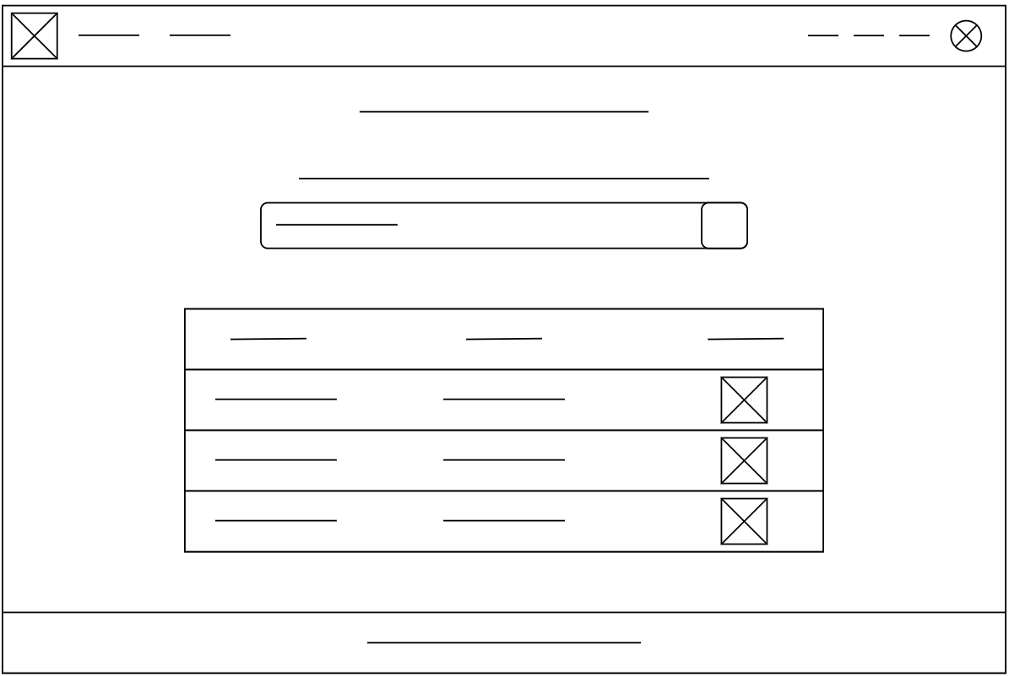
Page Selection and Logo
Profile and Settings
Digital wireframes
Home Page
Search Bar
Projects List

Slide 27
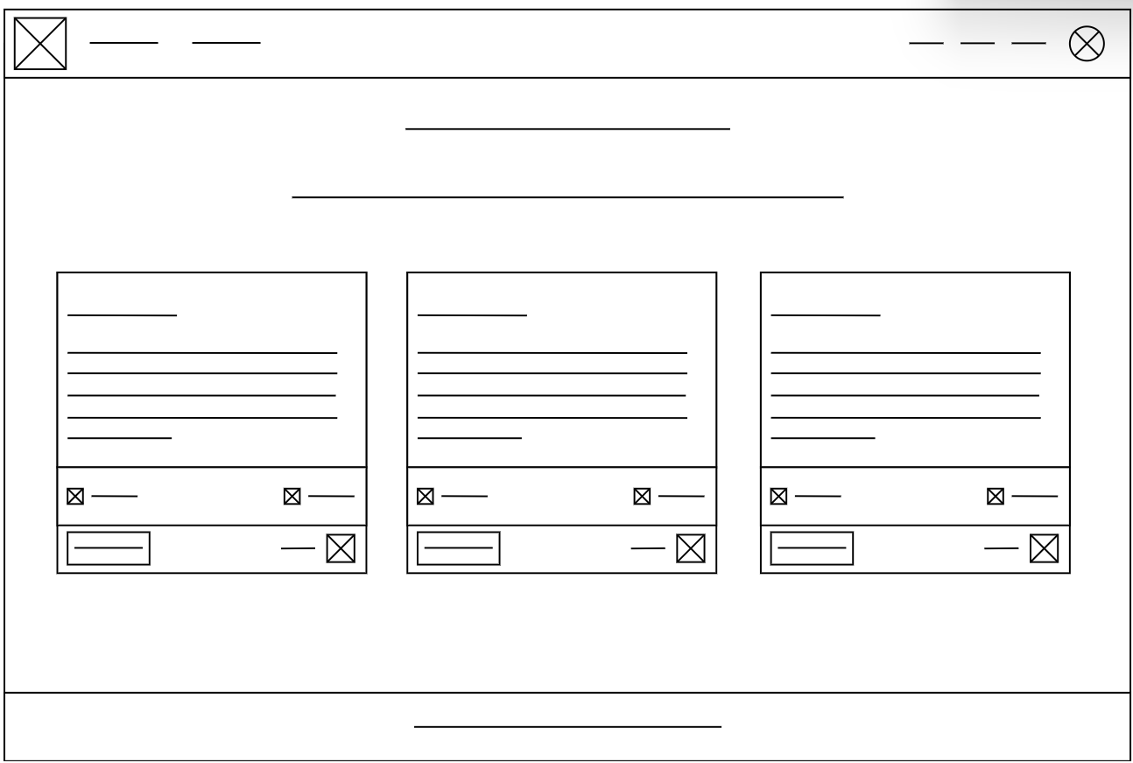
Digital wireframes
My Projects Page
My Projects
Enter Project Info Section
Fast Clone Repository

Slide 28
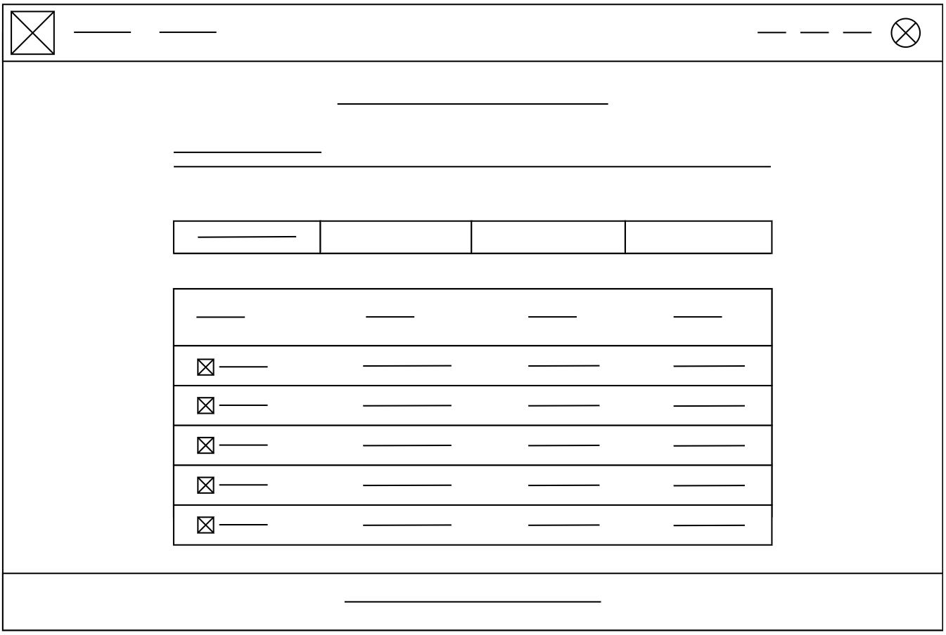
Digital wireframes
Project File Overview Page
Project Info Tabs
Project Files List
File Info

Slide 29
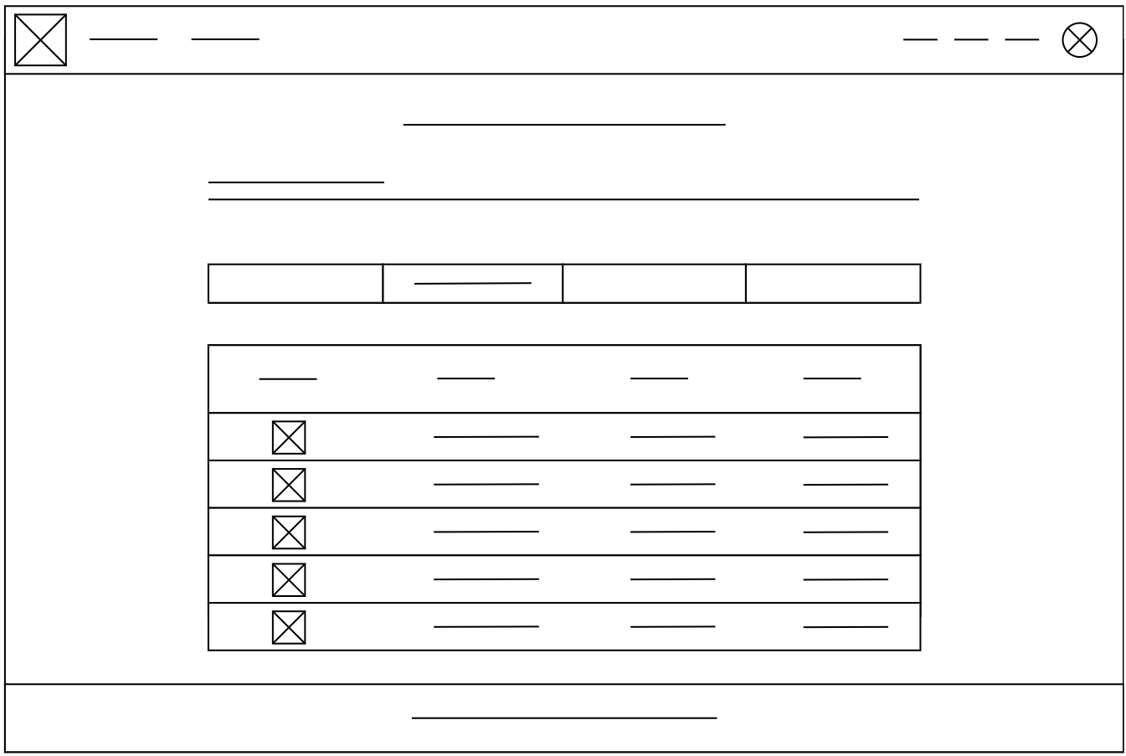
Digital wireframes
Project Commits Overview Page
Commit List
Commit Info

Slide 30
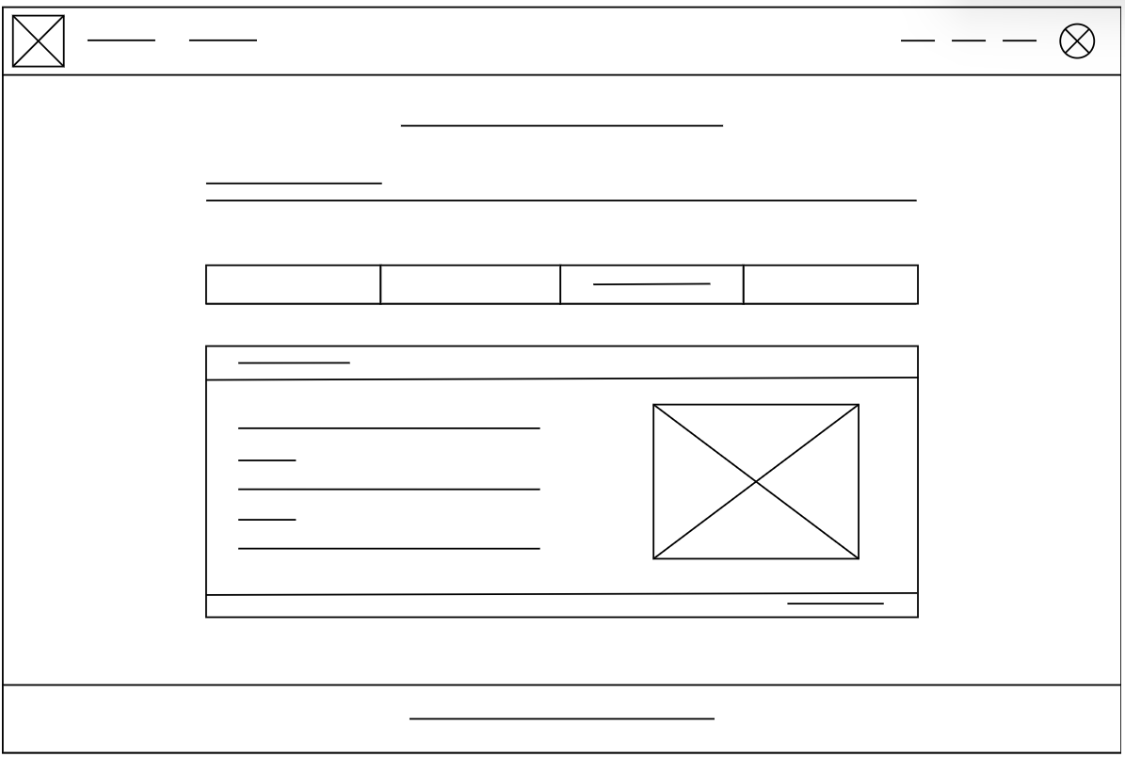
Digital wireframes
Project General Overview Page
Some Info Graph
Project Info

Slide 31
Accessibility considerations
1
2
3
The design aim to facilitate access to projects info
The design aim to give the user a faster and more intuitive way to clone the repository
The design aim to refactor the general website appearence

Slide 32
Usability test: participants, setting, materials
Write information about:
The participants of the Usability Testing Session were Computer Science students.
The Session was taken in class on our own PC.
The participants were asked to complete some task like:
Reaching one of your project general info page
Clone a repository
Access to your profile info
Find who made a specific commit and when

Slide 33
Usability test: findings
The participants have already had some experience with the older version of SCM and they find our design much nicer. Generally speaking, all of them found the User Experience improved, with minor fixes to be done.
Findings
1
Let the user automatically copy the clone command, not only show it.
2
Add Tags as search filters.
3
Add Search Bar in “My Project” page

Slide 34
Mockups
Before usability study
After usability study
[Your notes about goals and thought process]
Image of selected screen before usability study
Image of selected screen after usability study

Slide 35
Mockups
Before usability study
After usability study
[Your notes about goals and thought process]
Image of selected screen before usability study
Image of selected screen after usability study

Slide 36
Mockups
Main mockup screen for display
Main mockup screen for display
Main mockup screen for display
Main mockup screen for display

Slide 37
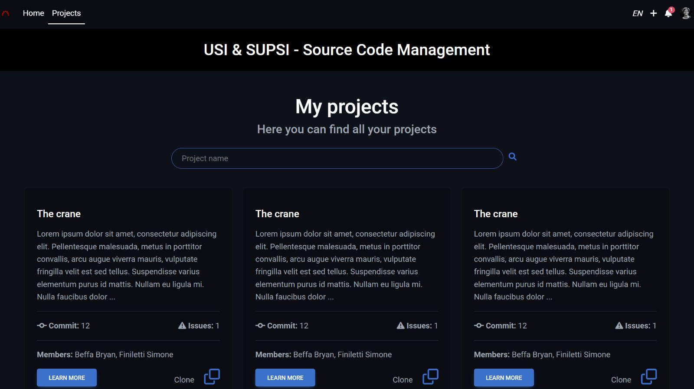
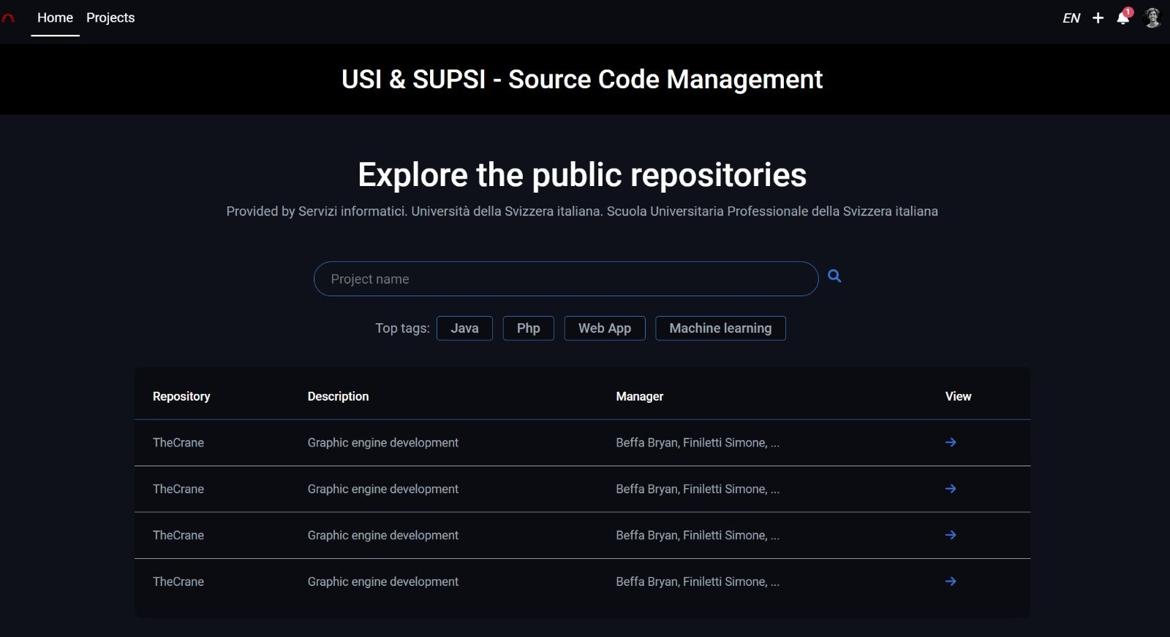
My Projects
High-fidelity prototype
Home
https://localhost:8080/SCMRefactor/homepage.php

Slide 38
Going forward
Takeaways
Next steps

Slide 39
Takeaways
Impact:
Overall, we have had a positive review of our design. Users are happy with how the site looks and how functionalities are more intuitive and easier to reach.
What I learned:
We have learned that for the development of a User Experience project (as for other fields) , it is not enough to have an idea and implement it, but we must follow a definite pattern that then benefits the quality of the project and the implementation of our idea.

Slide 40
Next steps
1
2
Look for other improvements that will be suggested after other users tries our design
Add more functionalities that could be useful and refactor also all other older SCM pages.

Slide 41
Thank you!

